Slide 1
TAKE HOME EXERCISE #3 WITH ANSWERS
DATA STORYTELLING

Slide 2
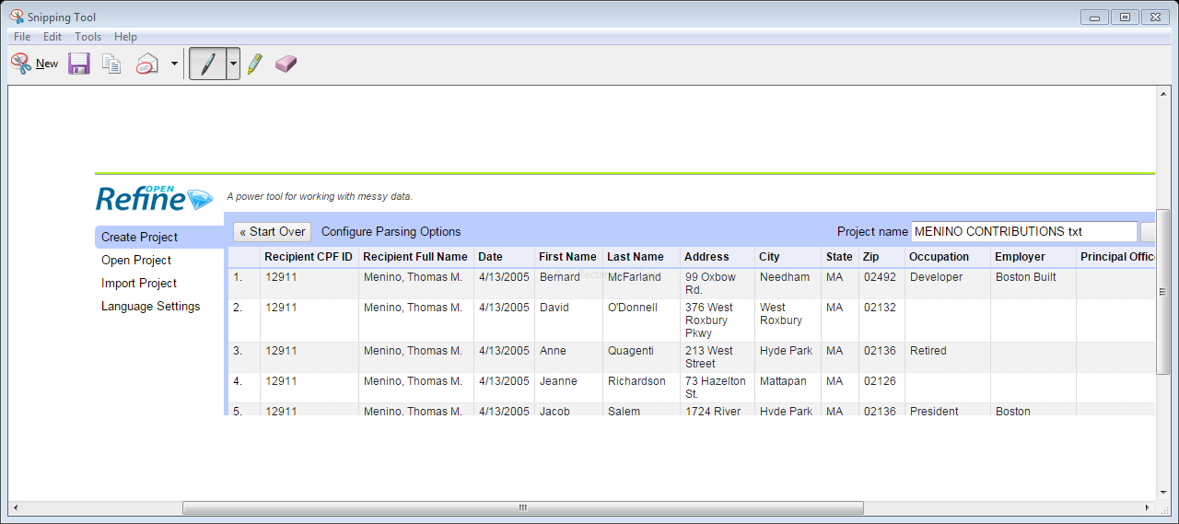
CLEANING DATA WITH OPEN REFINE (
Open refine on your computer:
OpenRefine.Org
Go to the Office of Campaign and Political Finance
Export to a TEXT FILE all contributions to former Mayor Thomas M. Menino
Import to OpenRefine as a new project

Slide 3
CLEANING DATA WITH OPEN REFINE
Do your “four corners” test – how many records do you have in total?
How “dirty” is your data – what three things do you spot that would make it easier to analyze to spot a pattern or story?
List three things you would clean here AND why?
1.
2.
3.

Slide 4
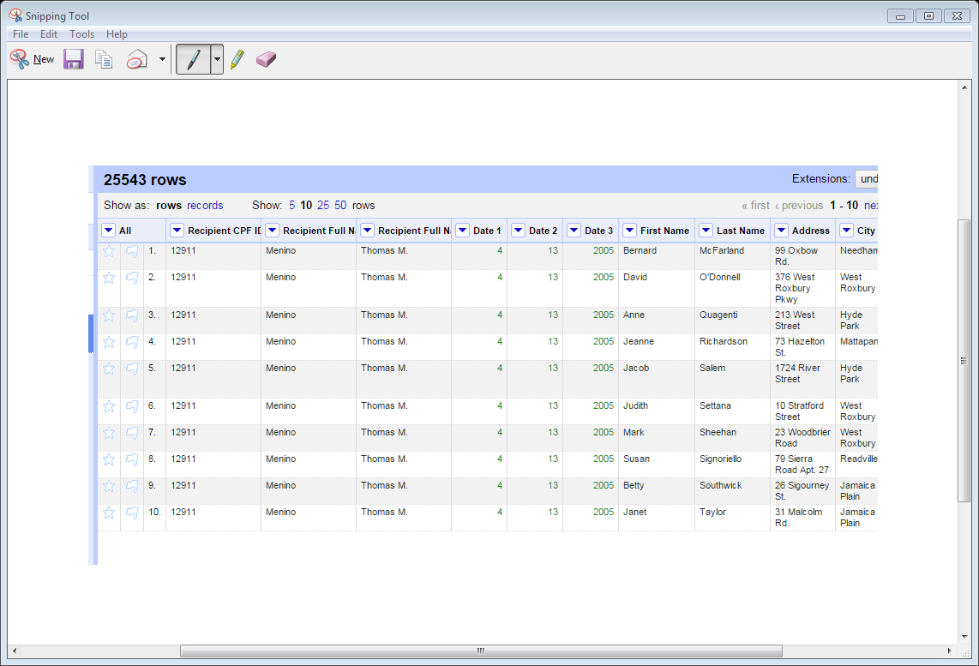
CLEANING DATA WITH OPEN REFINE
Using the cleaning methods we learned in class, do the following to get the result on right:
Split Menino’s name into two separate columns: last name, first name with middle initial
Split the data into three different columns: month, date and year
*hint: you’ll need to put in the right separator for this to split properly

Slide 5
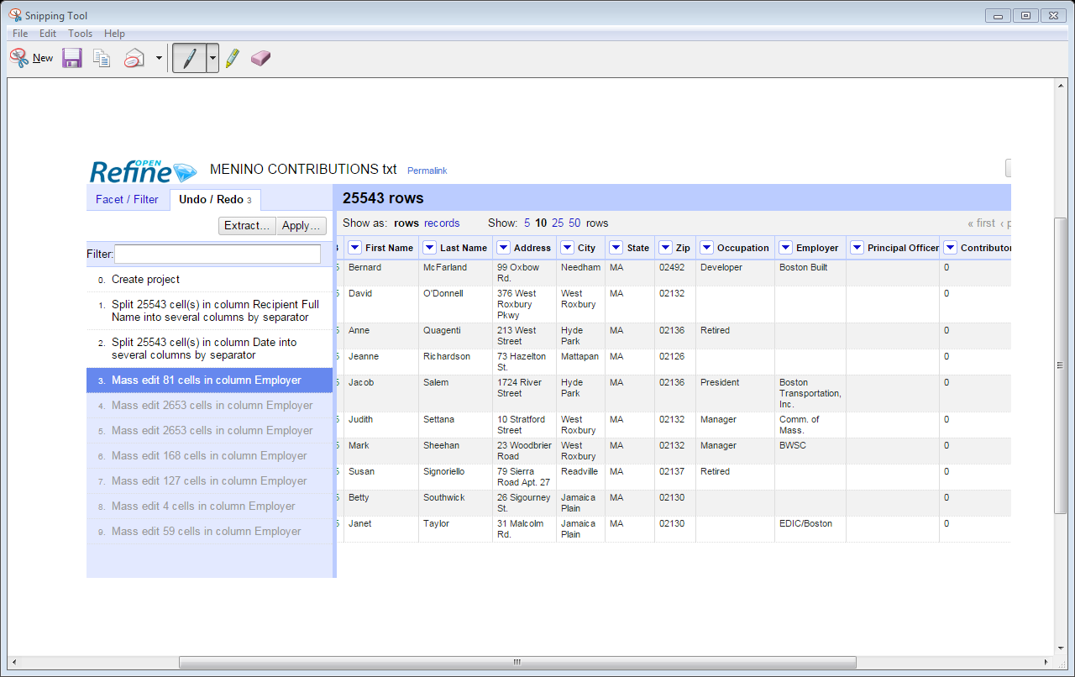

Slide 6
CLEANING DATA WITH OPEN REFINE
now clean the “OCCUPATION” and “EMPLOYER” columns
Using the TEXT FACET commands, determine first:
The total number of different occupations in the data
The total number of different employers in the data
QUESTIONS AND ANSWERS
How many different occupations are there?
2558
How many different employers are there?
6617

Slide 7
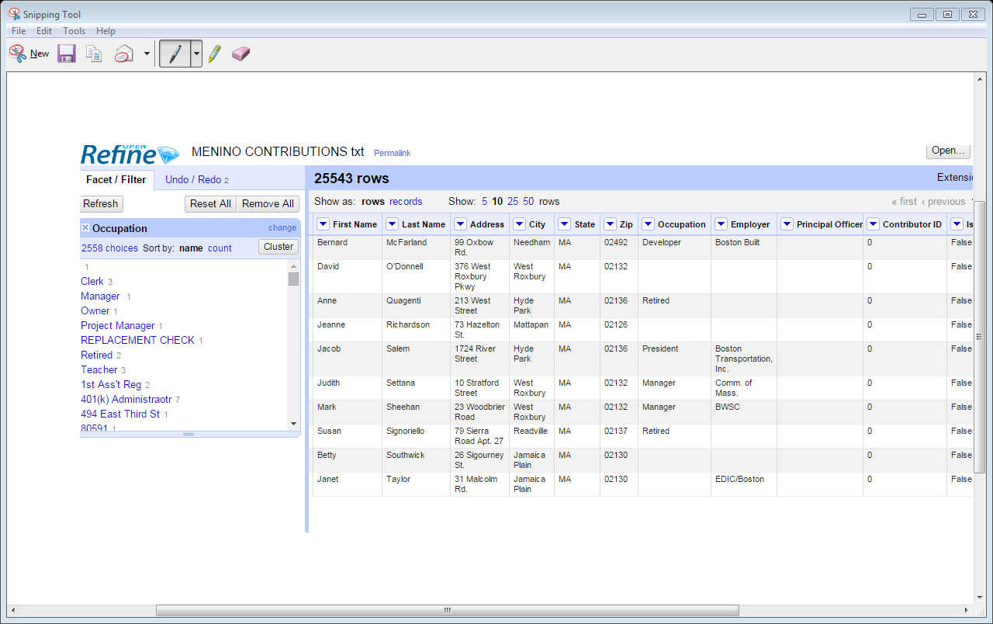

Slide 8
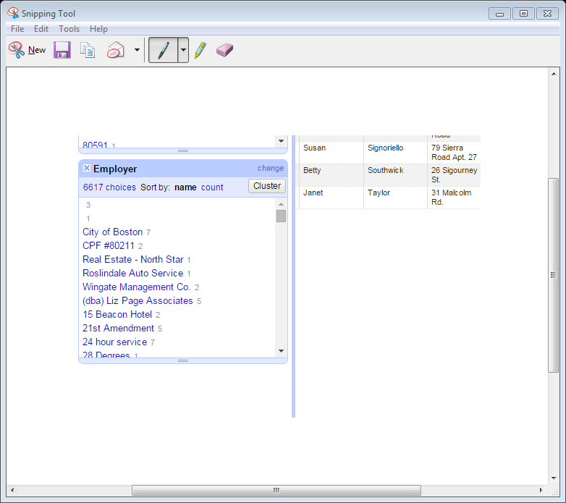

Slide 9
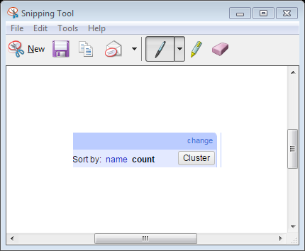
CLEANING DATA WITH OPEN REFINE
Using the COUNT command,
answer the following questions:
What is the largest occupation?
Attorney
What is that number?
2152
What is the largest employer?
City of Boston
What is that number?
1676

Slide 10
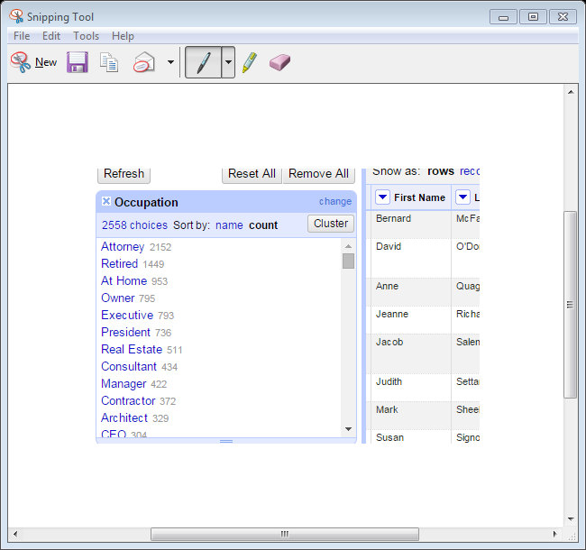

Slide 11
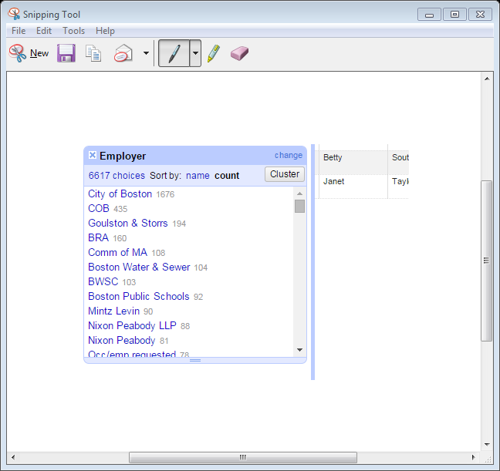

Slide 12
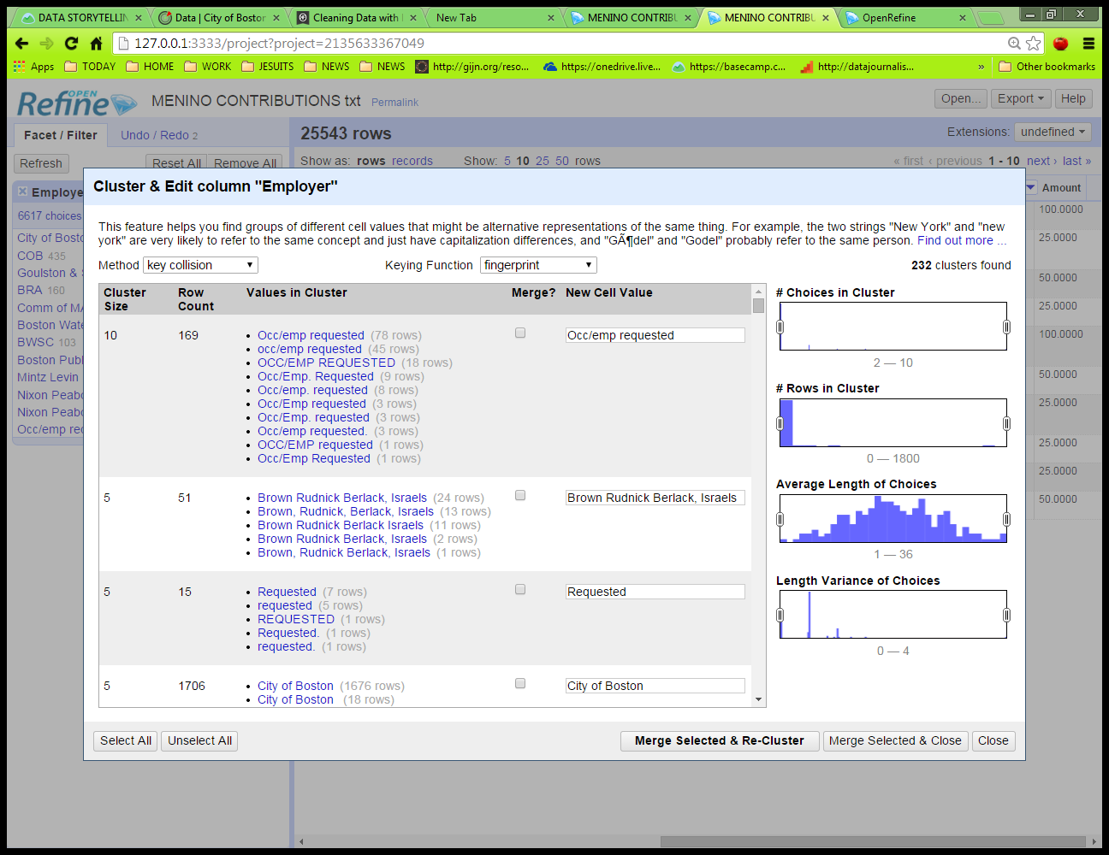
CLEANING DATA WITH OPEN REFINE
Let’s CLUSTER the EMPLOYERS with they keying cluster as FINGERPRINT
How many different EMPLOYER clusters are there in the column?
232

Slide 13
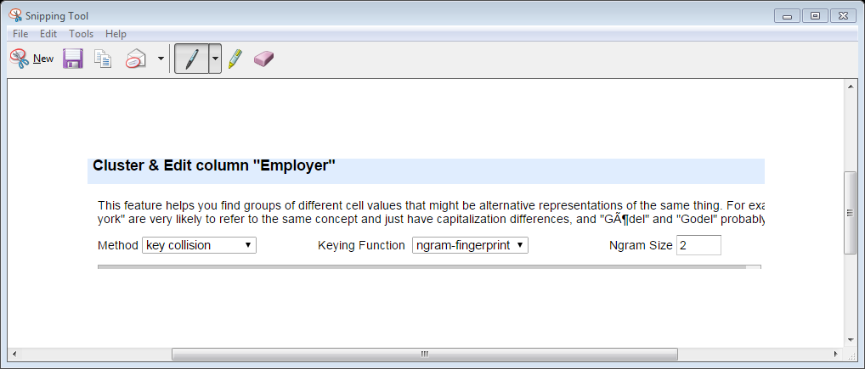
CLEANING DATA WITH OPEN REFINE
Try using the other three keying clusters to see if you get a different number for EMPLOYER cluster
What is the EMPLOYER cluster number if you change the keying function to n-gram-fingerprint?

Slide 14
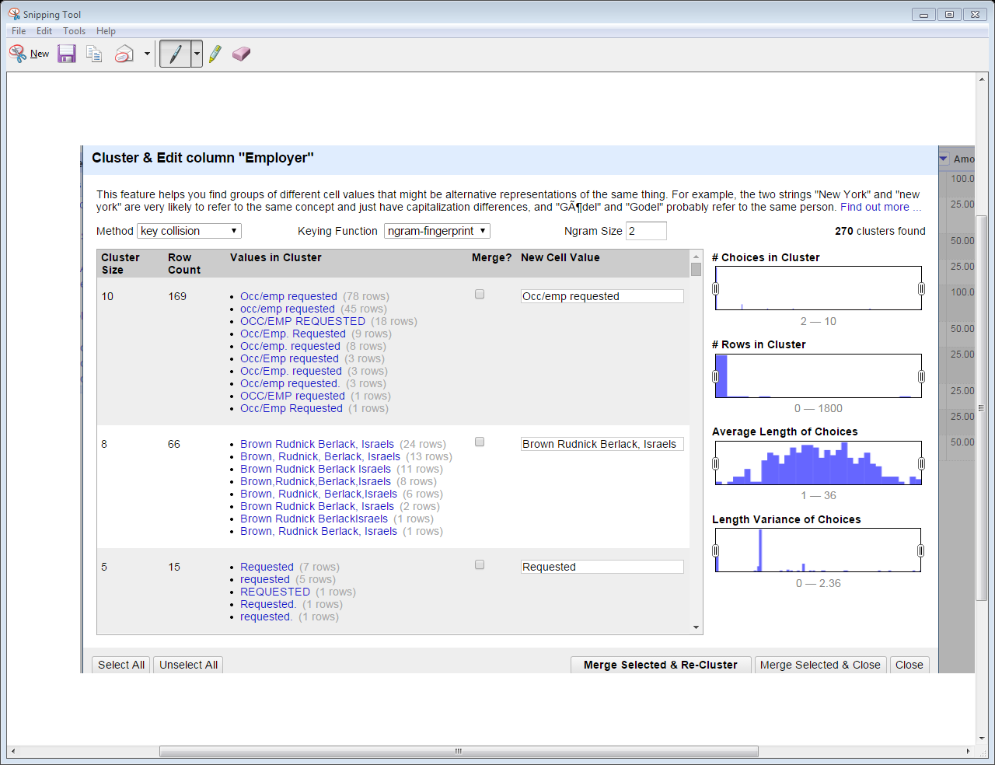

Slide 15
CLEANING DATA WITH OPEN REFINE
If you change the keying function to metaphone3, now how many EMPLOYER clusters do you get?
618

Slide 16
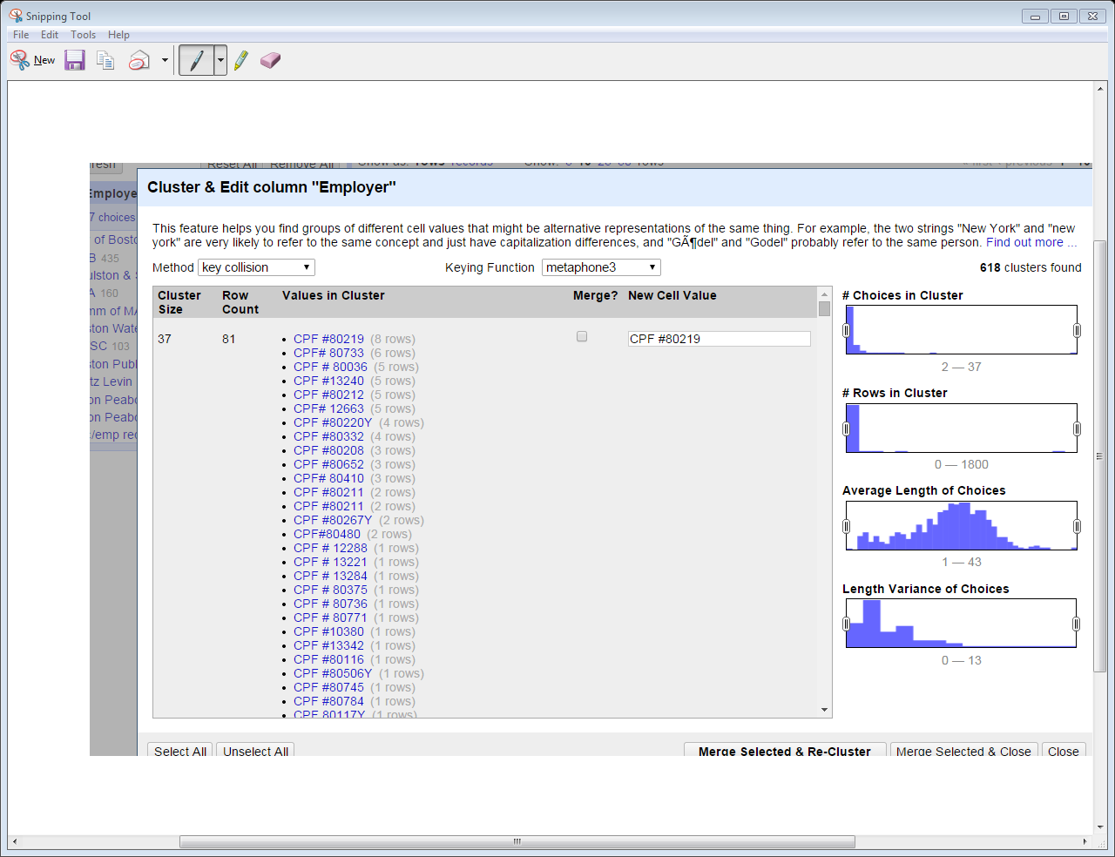

Slide 17
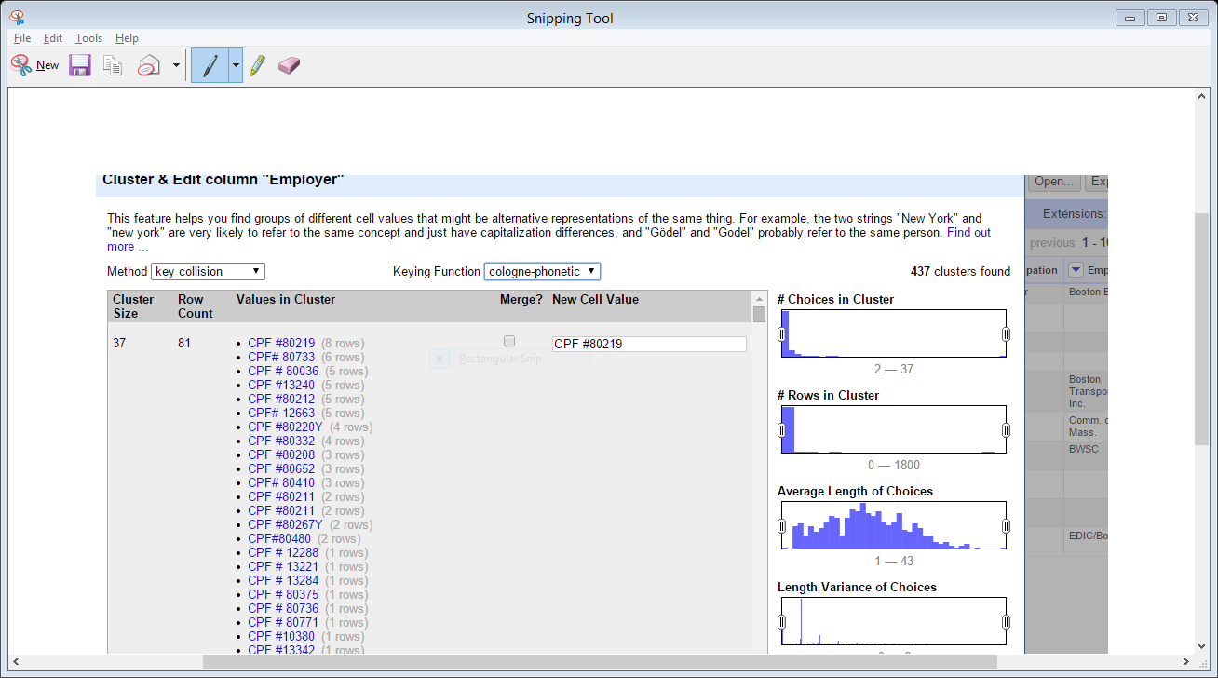
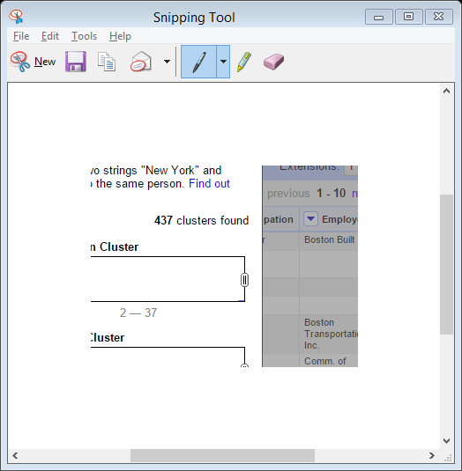
CLEANING DATA WITH OPEN REFINE
IF YOU USE THE COLOGNE – PHONETIC KEYING FUNCTION, YOU’D GET 437 CLUSTERS FOR EMPLOYER

Slide 18
CLEANING DATA WITH OPEN REFINE
Go back to the keying function FINGERPRINT
Select CLUSTER and answer the following:
How many EMPLOYER clusters do you have now?
you’d have 232 with the fingerprint cluster keying function selected
Select all the EMPLOYER clusters for an employer beginning with Brown, Rudnick; make sure to select all of them. Rename your cluster: BROWN RUDNICK

Slide 19
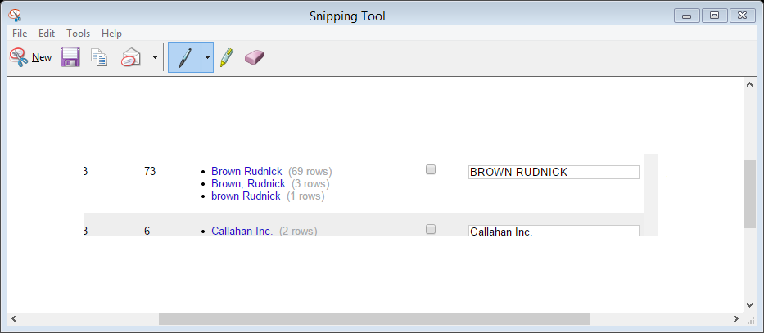
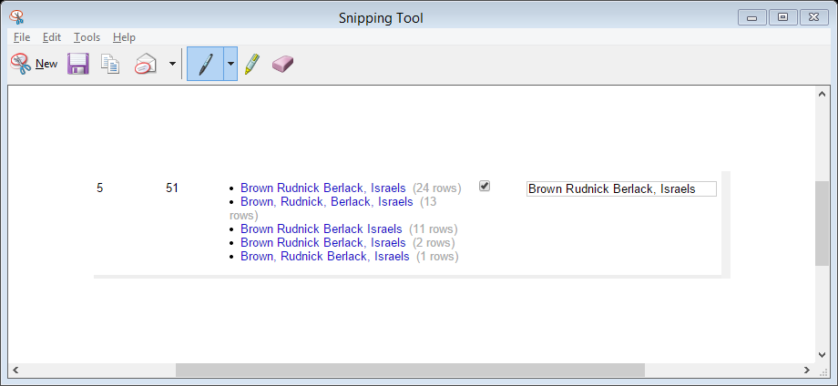
CLEANING DATA IN OPEN REFINE
BROWN RUDNICK #2
BROWN RUDNICK #1

Slide 20
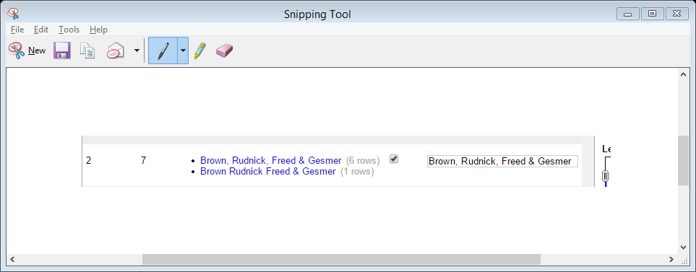
CLEANING DATA IN OPEN REFINE
Brown, Rudnick appears multiple times in the data in different ways
BROWN RUDNICK #3

Slide 21
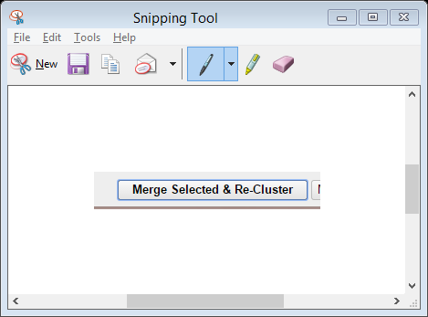
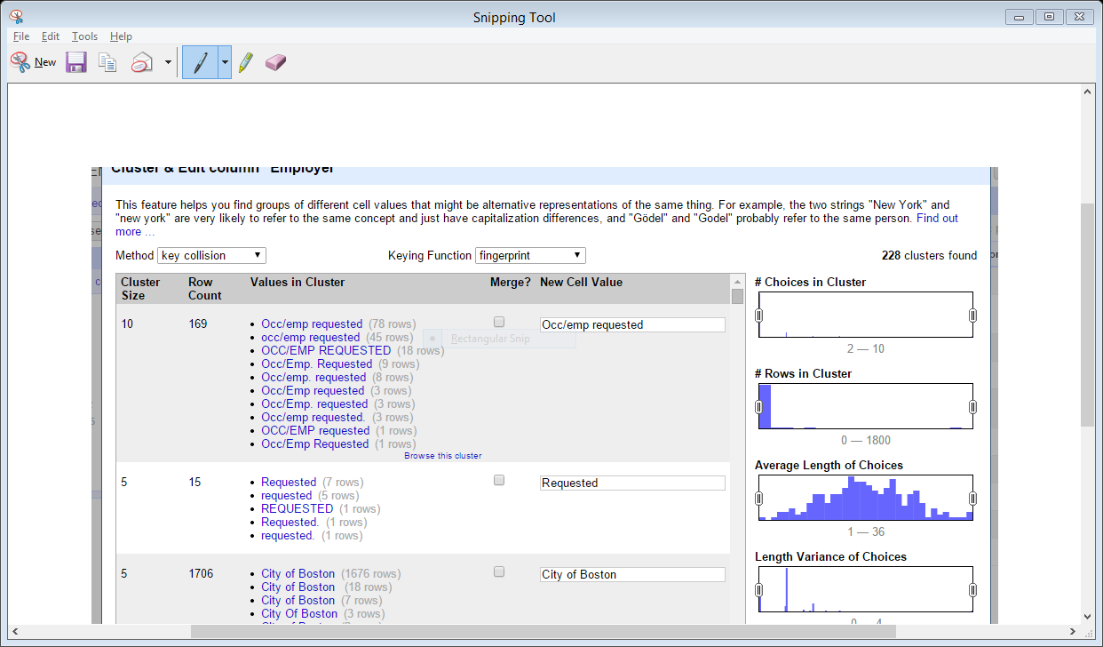
CLEANING DATA WITH OPEN REFINE
Select MERGE SELECTED & RE-CLUSTER for BROWN, RUDNICK
How many EMPLOYER clusters do you have now? 228
How many are in BROWN, RUDNICK?

Slide 22
CLEANING DATA WITH OPEN REFINE
Now you have 228 EMPLOYER clusters

Slide 23
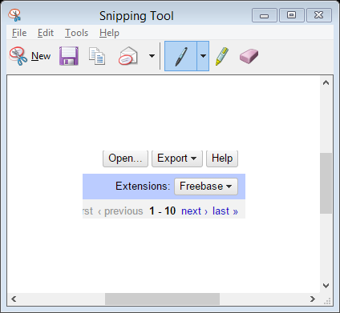
CLEANING DATA WITH OPEN REFINE
Now close your EMPLOYER cluster and go back to the main OpenRefine project
Click on EXPORT on the upper right:
EXPORT your MENINO file to your desktop as a comma-separated file; name it MENINO CONTRIBUTIONS ALL and save it to your desktop

Slide 24
VIZUALIZING DATA WITH GOOGLE FUSION TABLES
Open Google Drive and then Google Fusion Tables
Import the spreadsheet called Massachusetts Federal Firearms Licenses in Blackboard; you’ll find it in the folder EXERCISE 3 MATERALS
Create a new Fusion Table with the Firearms License data
Before you bring the data into Fusion Tables, how many records are there?
After you bring the data into Fusion Tables, how many rows of data are there?

Slide 25
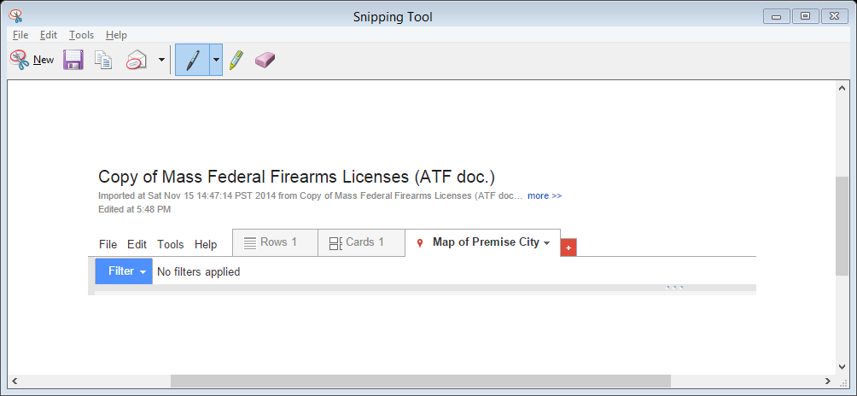
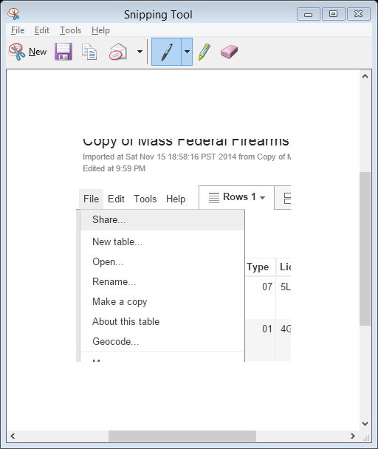
VIZUALIZING DATA WITH GOOGLE FUSION TABLES
GEOCODE THE DATA
Geocode the data; click on Rows
Click on File
Click on Geocode
for a location hint, type in Massachusetts – geocoding will take a few minutes but wait until it completes
GEOCODE THE DATA

Slide 26
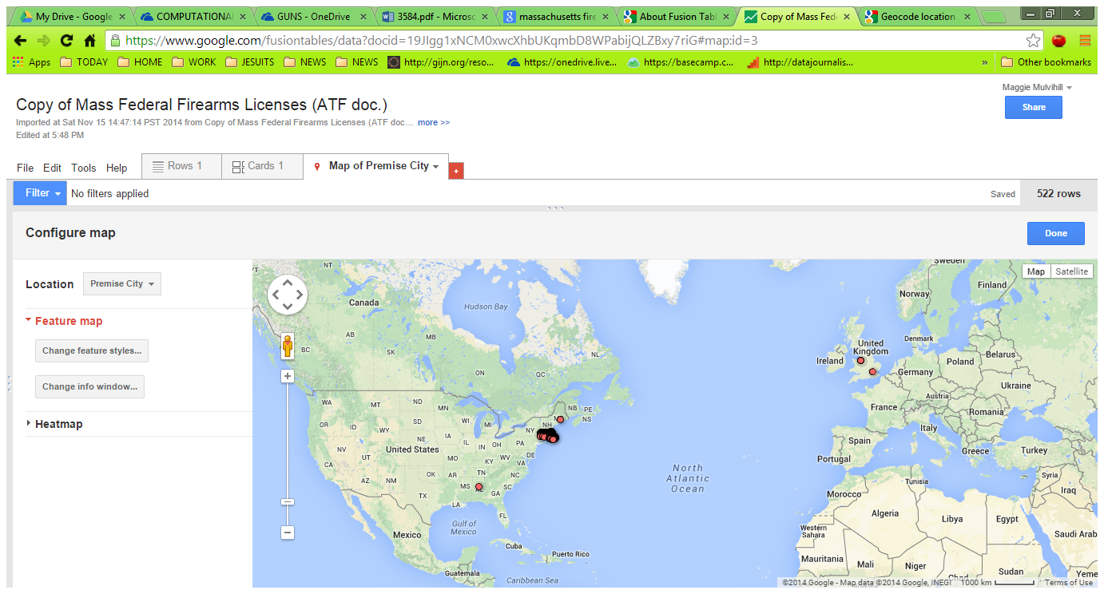

Slide 27
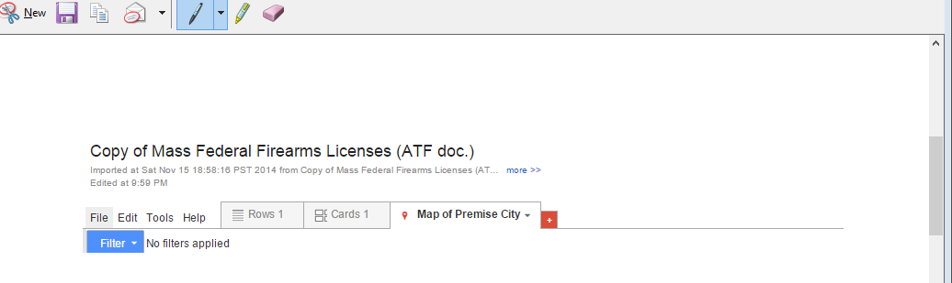
VIZUALIZING DATA WITH GOOGLE FUSION TABLES
Change to the Map view
Change your map style to use large purple markers throughout; save your map (refer to my Fusion Tables presentation for guidance)

Slide 28
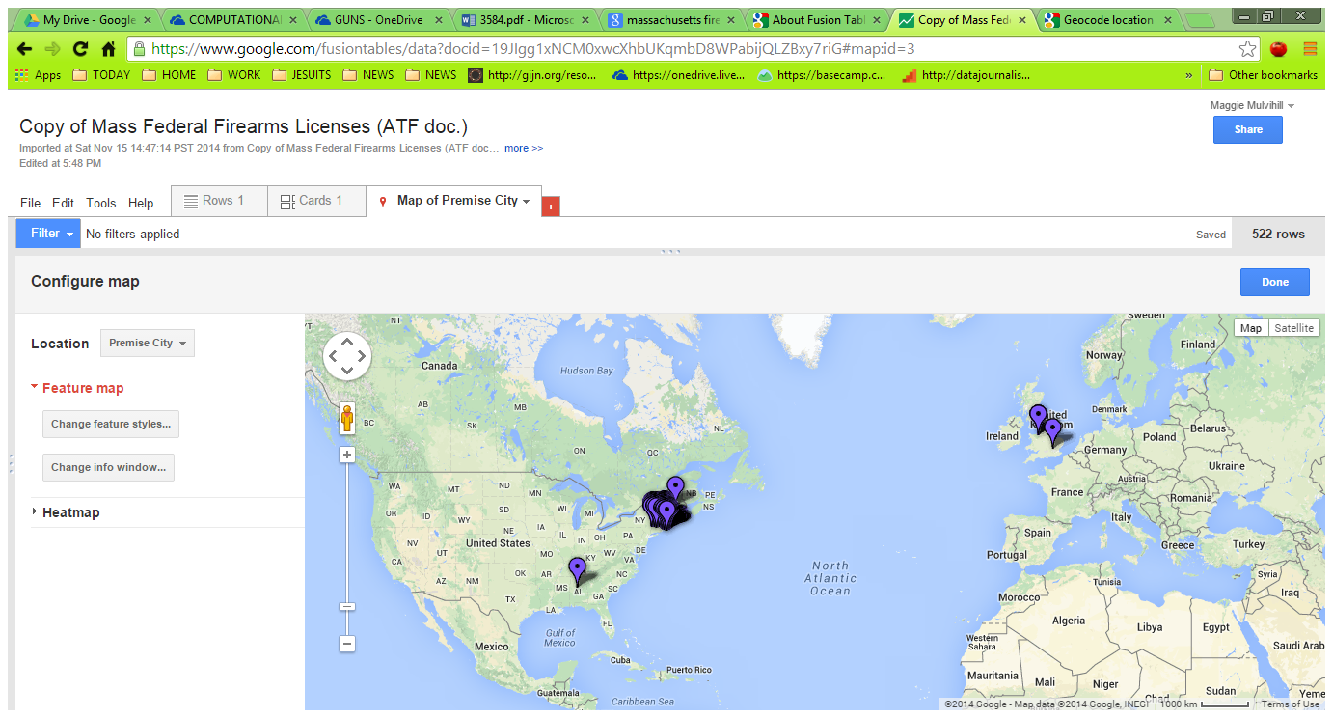

Slide 29
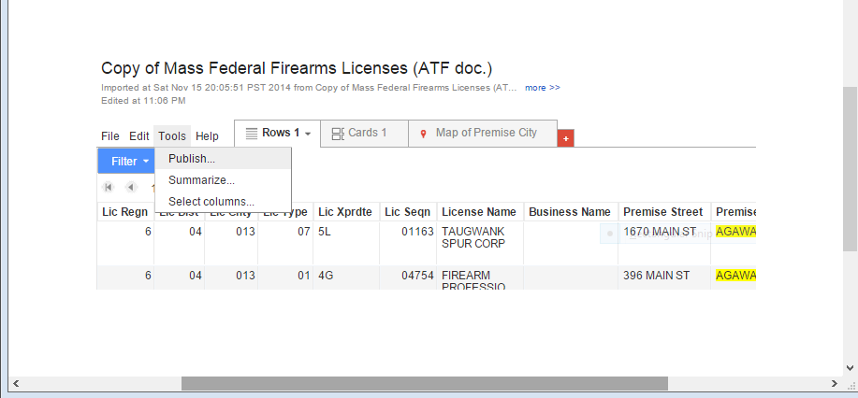
VIZUALIZING DATA WITH GOOGLE FUSION TABLES
Get out of the Map view; go back to the Row view
Go to Tools
Go to Summarize
Summarize by Premise City
Which city has the most Federal Firearms Licensed Dealers?
What is that number?

Slide 30
VIZUALIZING DATA WITH GOOGLE FUSION TABLES
Get out of the Map view; go back to the Row view
Go to Tools
Go to Summarize
Summarize by Premise City
Which city has the most Federal Firearms Licensed Dealers?
What is that number?

Slide 31
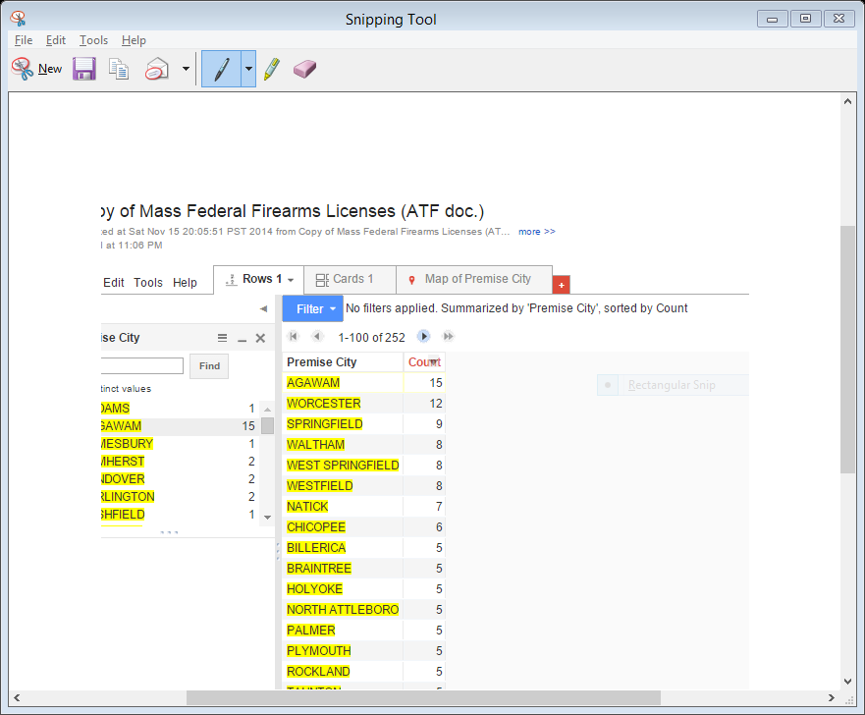
VIZUALIZING DATA WITH GOOGLE FUSION TABLES
Go to Tools
Go to Summarize
Summarize by Premise City
Which city has the most Federal Firearms Licensed Dealers? AGAWAM
What is that number? 15

